Slide 1
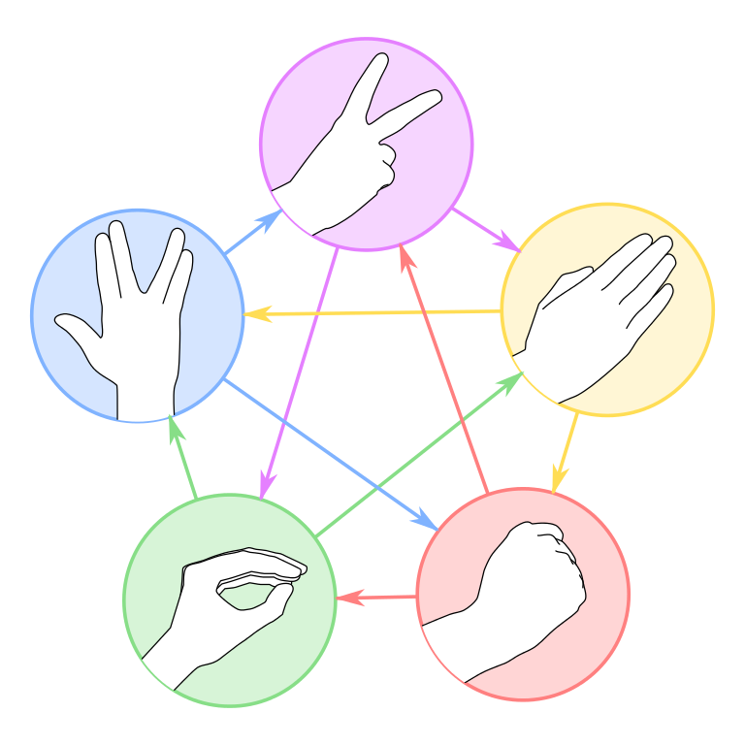
DETECTION OF HAND GESTURES AS STONE PAPER AND SCISSOR

Slide 2
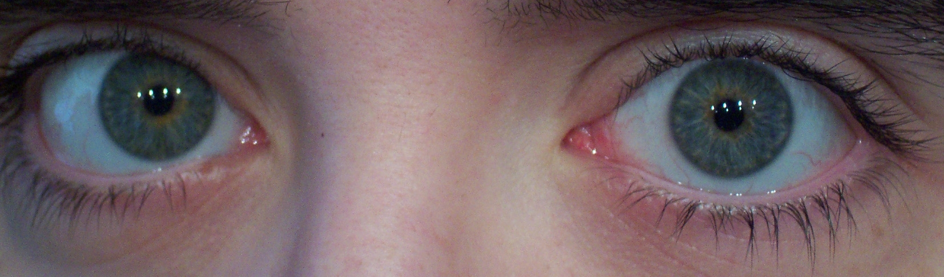
Is Project Helpful ?
The software will be helpful for visually impaired persons, who often have difficulty identifying denominations of currency notes. With the app, the user can identify a currency note through a picture clicked by phone's camera. It will then give a voice intimation to the user.

Slide 3

We have been motivated by a lot of work that has been done recently on computer vision. So we wanted to help the blind by making this software.

Slide 4
Well Maintained Dataset In Different Illumination and Background
Extract Best Features For Better Detection.
CHALLANGES

Slide 5
COMPUTER VISION
Computer vision is an interdisciplinary scientific field that deals with how computers can be made to gain high-level understanding from digital images or videos.

Slide 6
CONVOLUTIONAL NEURAL NETWORKS (DEEP LEARNING)
In deep learning, a convolutional neural network is a class of deep neural networks, most Commonly applied to analyzing visual imagery.

Slide 7
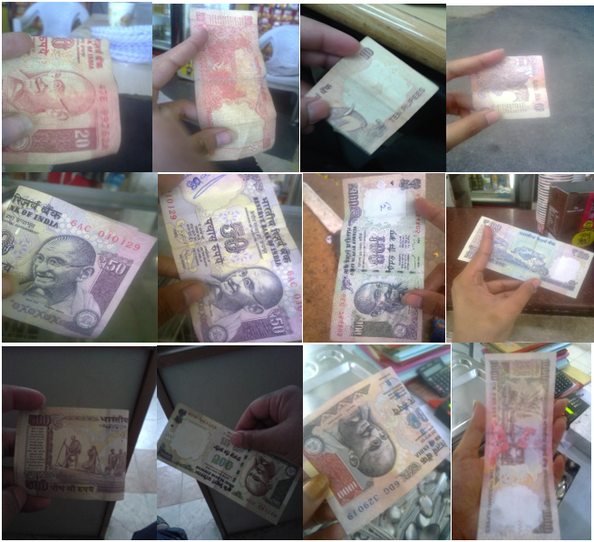
DATASET
Images from the dataset with bills in varying illumination and background
Source of the dataset -10Zinten

Slide 8
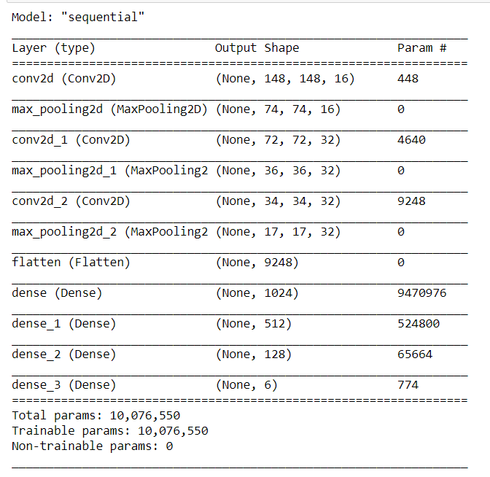
SUMMARY OF MODEL

Slide 9
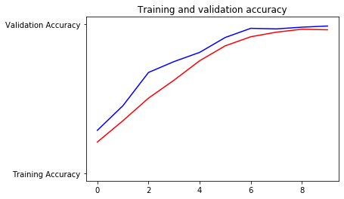
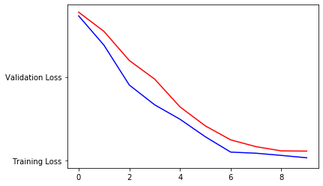
GRAPH OF ACCURACY AND LOSS AT EACH EPOCH
We have got 98.85% accuracy on test set and 96.32% accuracy on training set after 10 epochs.

Slide 10
OUR PROJECT
Our GUI contains 3 buttons
Load Model
Load model loads the image
Select Image
We can select desired image which we want to predict/classify
Predict
Predict gives us output by Audio/Text format.

Slide 12
HOW IT WILL BE USED

